Slide 1

Engineering Notebook
Patti Poston
FIRST Senior Mentor, Nevada

Slide 2
What is an Engineering Notebook?
Problem Definition Information Gathering Brainstorming Solutions Concept Design System Level Design Testing | Design Improvement Production Promotion Budgeting Planning Outreach

Slide 3
Why Do We Need a Notebook?
Document obstacles, lessons learned, draw ideas
Show the journey the team makes
Judges can see the journey
Show team from the beginning to end of season
Required for awards

Slide 4
Notebook Requirements
Check Updates Game Manual #1
2 Notebooks max
Team number and team name on cover
Should attach summary page – 1-3 pages
Engineering Content
Notes:
Engineering Notebook Requirements
Teams may not present more than two notebooks at a competition.
The team number must appear on the outside cover of the engineering notebook. Engineering notebooks will not be considered without this information. This is important because Judges can’t connect your engineering notebook to your team without this information.
Teams should attach a summary page to the front cover of the engineering notebook. The summary should be between one and three pages long and include a concise narrative about the team, school, or organization with bulleted highlights of the team’s season. The team summary page should also include the team number and a list of pages in the engineering notebook the team would most like the Judges to consider. Teams should list either the page number for those entries, or tab the pages they would like judges to pay extra attention to. Judges have many notebooks to look at. A summary page in your notebook helps them to focus on the work you are most proud of. Help them get to know your team better by adding a summary page.
The engineering notebook should include: a. Engineering content, Team information, A team plan.

Slide 5

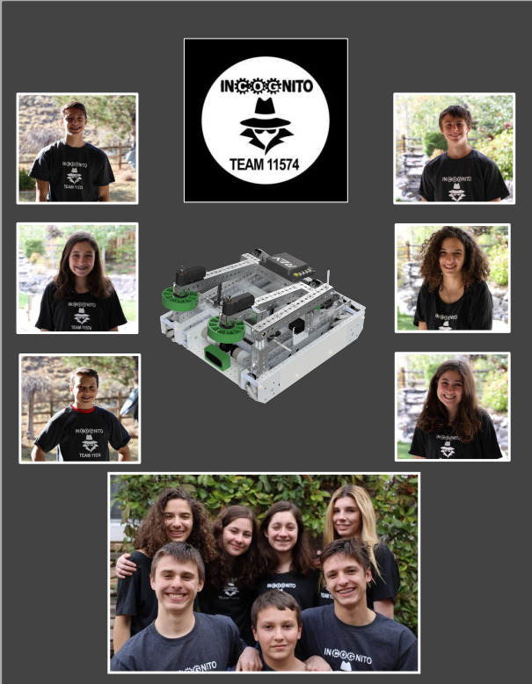
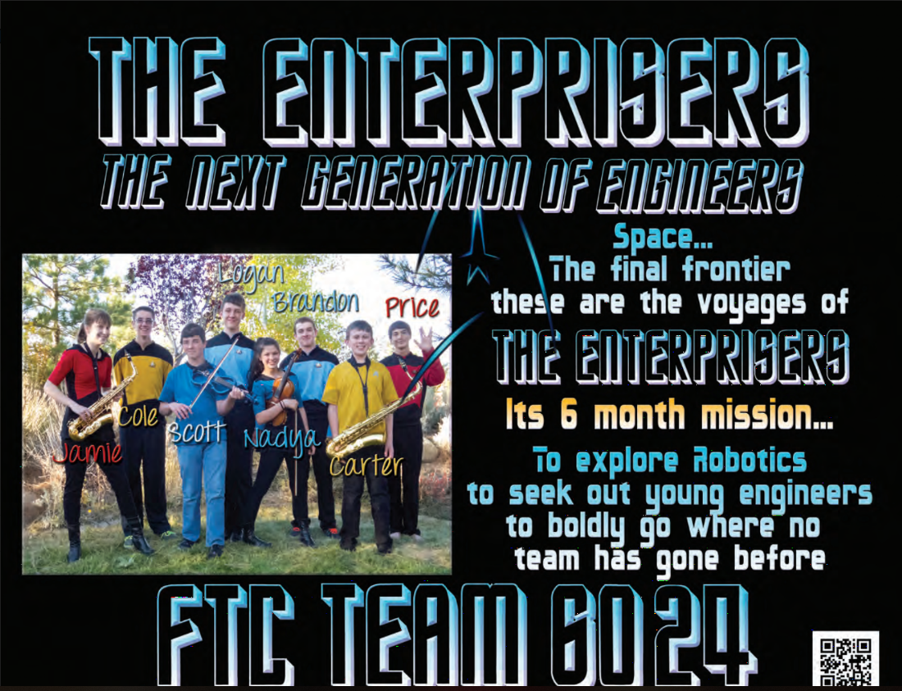
Name and Number

Slide 6
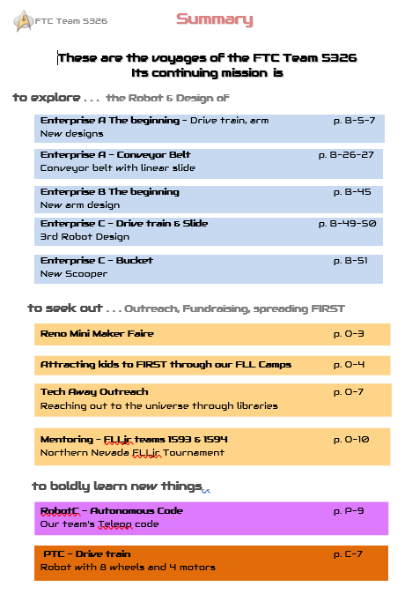
Summary Page
One to 3 pages
Include a concise narrative about the team
Include team number
Bulleted highlights of the team’s season
List of pages in the engineering notebook the team would most like the judges to consider

Slide 7
Engineering Notebook Contents
Engineering Content
Game Strategy
Design Process
Programming
CAD
Team Summary
Information about Team
Members/coaches
Team Meetings
Outreaches
Team Plan
Business plan
Strategic plan to meet goals
Sustainability Plan
Table of contents
Makes it easier for judges to find documentation

Slide 8
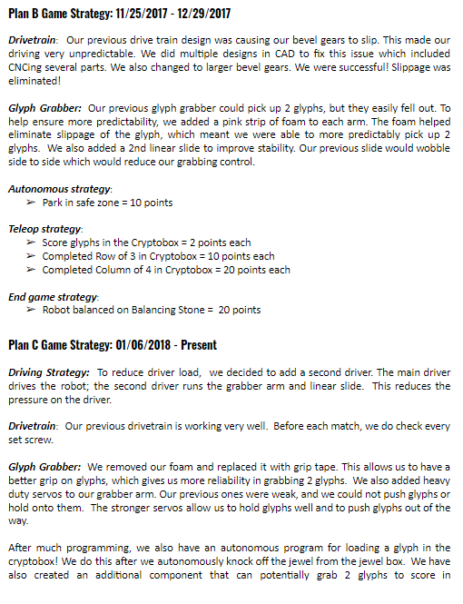
Game Strategy
Identify game challenges
Show tasks points - ranked
Show your strategy
Strategy for challenges and why
How strategy dictates robot
Explain design

Slide 9
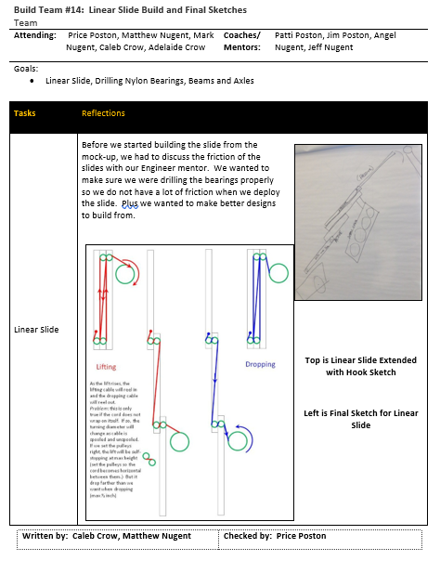
Design Process
Document from game reveal – competition
Sketches
Rough sketches - Napkins
CAD drawings
Photos
CAD Drawings
Math Equations
Electrical
Document design and changes

Slide 10
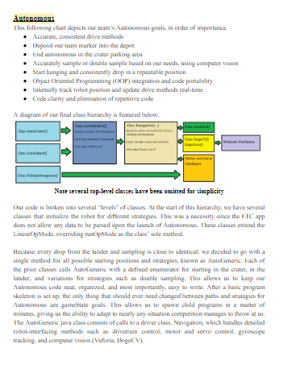
Programming Section
Overview programming process
Reasons for specific process
Implications of a sensor
Flowcharts & diagrams
Controller setup
Config of motors & servos
DO NOT PRINT OUT ALL OF YOUR CODE!
Only parts that you want to explain or showcase

Slide 11
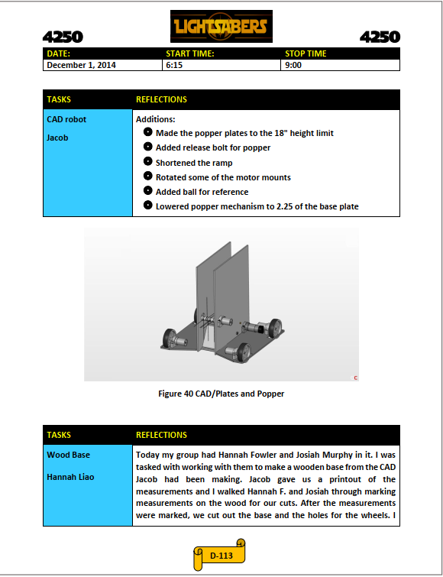
CAD Section
Add sketches, designs,
Measurements
CAD Drawings
Explain the reason for the design

Slide 12
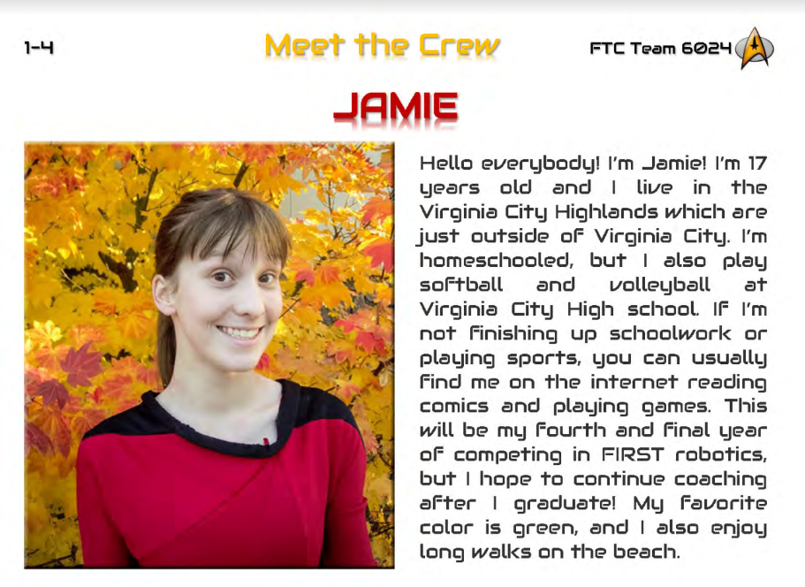
Team Summary
Team member bios
School year
Interests
Activities outside of robotics
Team role
Future plans
What got them interested
Mentor bios
Career
Team involvement
Personal history
Information about team
Hometown
Age
School

Slide 13
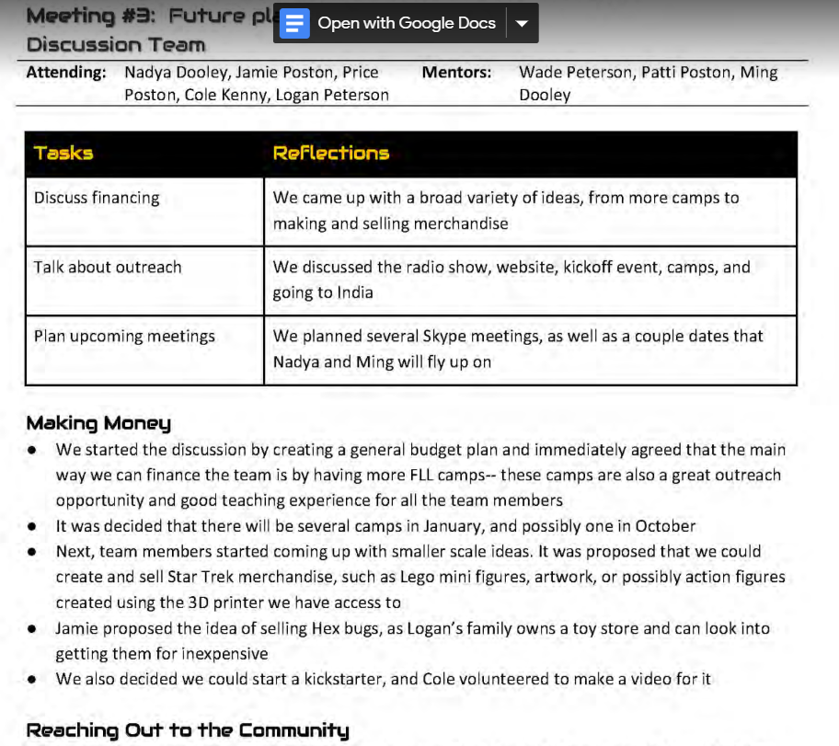
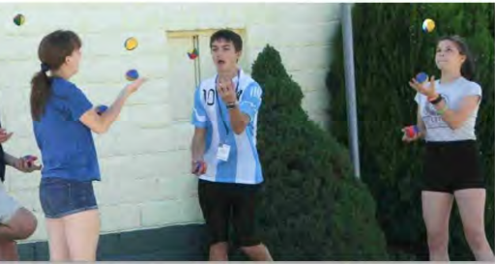
Team Meetings
Details about meeting
Date
Time
Location
Intentions
What was completed
What is ongoing
Future plans

Slide 14
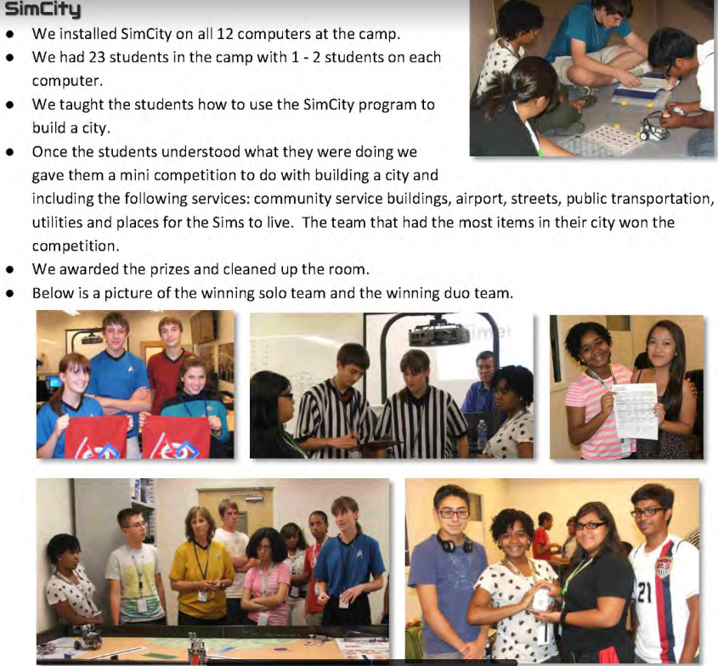
Outreach Section
Entry for each event/experience
Photos of the event
Explain the significance and impact
Give many details
Include takeaways
Who was at the event
FIRST, Community or Professional Outreach?

Slide 15
Credits
This lesson was written by Patti Poston
You can contact the author at: pposton@firstinspires.org
More lessons for FIRST Tech Challenge are available at www.FTCtutorials.com
Image Credit: 6024 Enterprisers, 5326 Enterprisers, 11574 Sonic Screwdrivers, 10464 Bionic Tigers, 4250 Light Sabers, 5687 Cyber Mafia
This work is licensed under a
Creative Commons Attribution-NonCommercial-ShareAlike 4.0 International License.

